Slide 1
Ordinal
Numbers
REVIEW 1st – 4th

Slide 2
Order
To be positioned in a certain way or manner

Slide 3
The bee is not one in line.
The bee is first in line.
We use Ordinal numbers such as first, second, and third to show position.

Slide 4
The mother is first in line.

Slide 5

The pink butterfly is second in line.

Slide 6
The third clock is a digital clock.

Slide 7
The football is fourth in line.

Slide 8
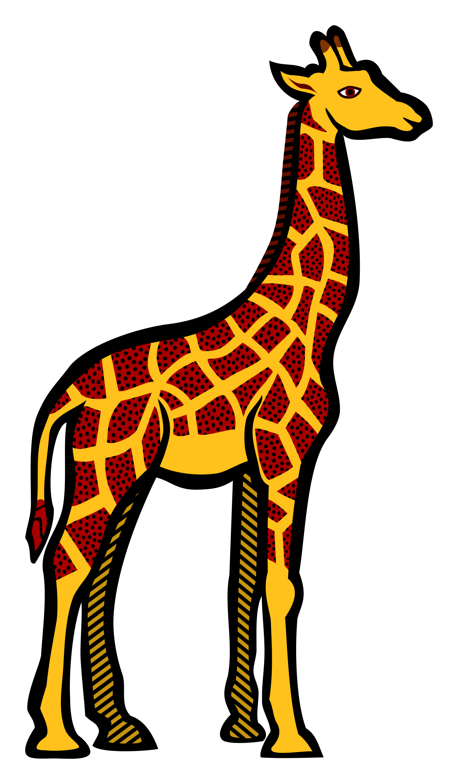
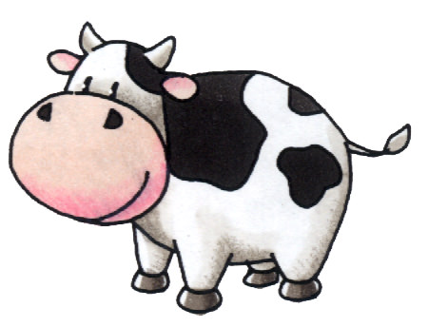
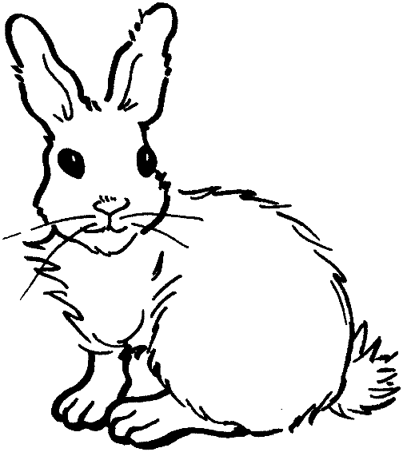
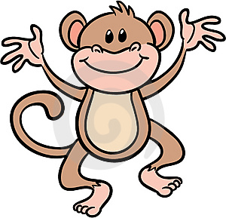
Which Animal is _____ ?
Review 1st, 2nd, 3rd, & 4th positions
2nd
3rd
4th
1st

Slide 9
Practice
Which is ______
4th
3rd
2nd
1st

Slide 10

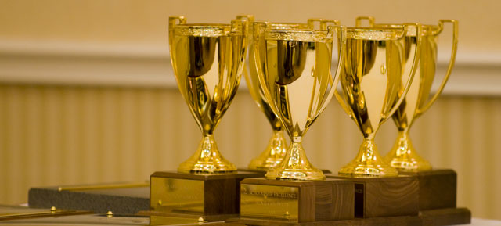
What comes after 4th?
Ordinal positions are most common in 1st – 3rd positions.
Lucy won 2nd place in the disk competition.
Kelley won 1st place in the beauty pageant.
Jessie won 3rd place in the singing competition.

Slide 11
But…
Ordinal positions can occur at any level!
5th, thirty-sixth, 91st, 111th…
You could even be the 4,268th person to read a certain book or even sing a song!
Let’s look at what comes after 4th!

Slide 12
fifth
5th

Slide 13
The fifth penguin is upside down.

Slide 14
sixth
6th

Slide 15
The sixth bee is smelling a rose.

Slide 16
seventh
7th

Slide 17
The seventh bear is running from bees.

Slide 18
eighth
8th

Slide 19
The eighth dog has on sunglasses.

Slide 20
ninth
9th

Slide 21
The ninth cat is black.

Slide 22
tenth
10th

Slide 23
The tenth bee is carrying honey.

Slide 24
What Order is it?
Look at the pictures on the next slides and determine the position of the underlined object.

Slide 25

What’s the Ordinal Position?
5th
7th
9th
NEXT →

Slide 26

What’s the Ordinal Position?
6th
9th
14th
NEXT →

Slide 27
What’s the Ordinal Position?
1st
3rd
5th
NEXT →

Slide 28

What’s the Ordinal Position?
8th
4th
6th
NEXT →

Slide 29

Correct!
Great Job
Next →

Slide 30

Try Again
Try Again →

Slide 31
Play a game
The Cats In Line Activity Page

